Slide 1

Microsoft Excel 2013
Dr. Wameedh. T.M. Al-Tameemi

Slide 2
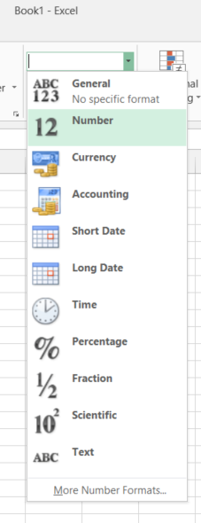
Excel 2013 Formulas
Calculation with dates
Excel also allows you to perform calculations with dates. All dates are stored in Excel as sequential numbers. By default, January 1 1900 is serial number 1, and January 1, 2004 is serial number 40933 because it is 40,933 days after January 1, 1900. Excel stores times as decimal fractions because time is considered a portion of a day. Because dates and times are values, they can be added, subtracted, and included in other calculations. You can view a date as a serial value and a time as a decimal fraction by changing the format of the cell that contains the date or time to General format.
Viewing dates as numbers
To view dates as numbers:
Select the cell and click Cells on the Format menu.
2. Click the Number tab, and then click Number in the Category box.

Slide 3
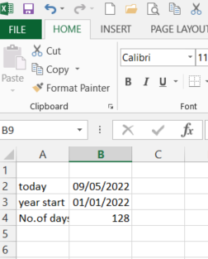
Excel 2013 Formulas
Calculating the difference between two dates
In the following example the date in cell B3 has been subtracted from the date in cell B2. The result in cell B4 has been formatted to display a number (the number of days between two dates) with no decimal places.

Slide 4
Excel 2013 Formulas
NB: You will need to format the result of the formula to a number format, as it may display as a date.
If you want to know what the date is 3 weeks’ time, and you have the current date in cell A1, then your formula could be: =A1+21 NB Excel won’t recognize a date just typed in directly into a formula: Eg =9/5/2022+21. You would have to use a date function to convert the date into one that Excel can understand as below:
=Date(2022,5,9)+21 The arguments being: (year,month,day)
=Today() Current date – this is a dynamic date (will change every day). You could use this in a formula to see what the date will be in 3 weeks’ time from today’s date: =Today()+21
=Now() Current time

Slide 5
Excel 2013 Formulas
Precision formatting
Care must be taken when working with formatted numbers. It is important to remember that formatted numbers, i.e. the numbers which appear on the screen, may not be the same as the value stored in the cell or the numbers used in calculations. The discrepancy can cause the results displayed to be different from the manually calculated answers.
In the example opposite, there are two columns of numbers that appear to be the same. The first column adds up to 95 but the second column adds up to 100. Take a close look at the value stored in cell A1, as displayed in the Formula bar. The value stored in all the cells in the first column is actually 9.5. This has been formatted to appear as a whole number (integer). The calculation is actually correct (10*9.5=95), although it appears to be incorrect. The problem can be avoided by using number formats cautiously, or it can be resolved by setting the precision for the entire worksheet as explained below.

Slide 6
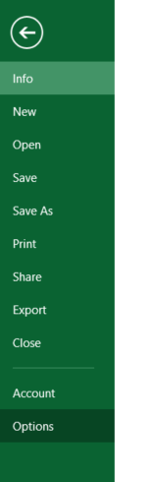
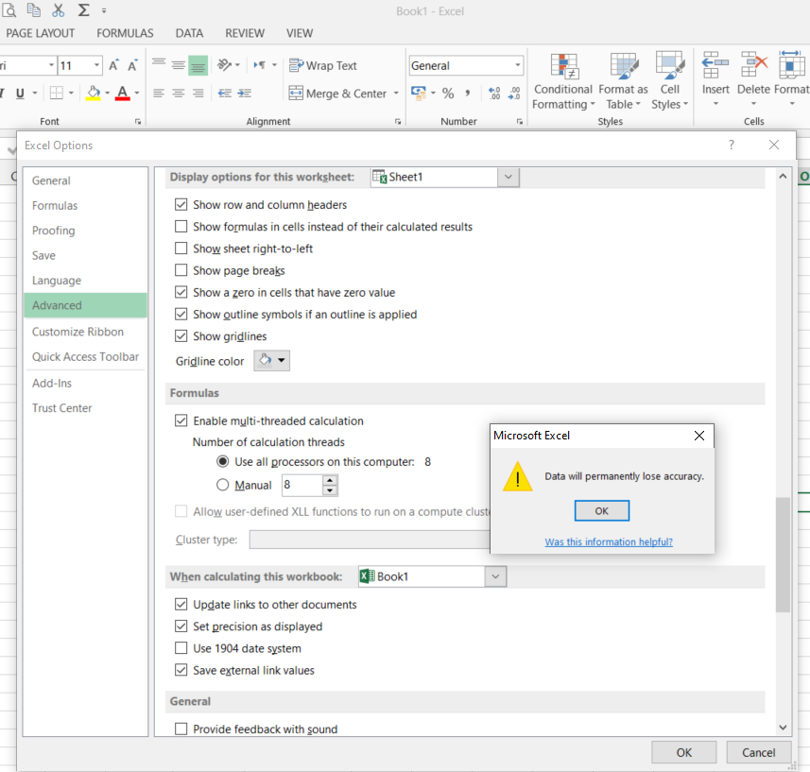
Excel 2013 Formulas
Setting the precision of number formats
To set the precision of number formats for an entire worksheet:
1. Click the File tab, then select Options
2. Click on the Advanced category
3. Scroll down to When calculating this workbook
4. Choose the Precision as displayed box and click OK
When you choose OK you are warned that constant numbers throughout the workbook will be rounded permanently to match cell-formatting.
2
This will affect all cells in the worksheet. If you only want to round certain cells, then you can use the =ROUND function to round to a specific number of decimal places or the =INT function to convert to an integer only.
3
1

Slide 7
Excel 2013 Formulas
=ROUND (number; number of digits) = round(2.5678;2)=2.57
=Int(number) = int(2.5678) = 2

Slide 8
Excel 2013 Formulas
Statistical & mathematical functions
Some of the most commonly used statistical and mathematical functions are shown below.

Slide 9
Excel 2013 Next
Next lecture:
Thank you very much

